Slide 1




NEXT GEN EMPLOYABILITY PROGRAM
Creating a future-ready workforce
College Name
Student Name : A.M.K.Lohitha
Student ID : au814721104033
SRM TRP Engineering College

Slide 2

CAPSTONE PROJECT SHOWCASE
Project Title
Notes Sharing Web Application using Django Framework
Abstract | Problem Statement | Project Overview | Proposed Solution | Technology Used | Modelling & Results | Conclusion

Slide 3
Abstract
This project aims to develop a notes sharing web application using the Django framework, with the separate login portals for students and teachers.
The application allows the student to create an account, download notes and share notes with others. They can also search for notes, comment on them, and like them.
Teachers, on the other hand, can create accounts, upload notes, and manage their content. They can also view and moderate student comments.
The application includes user authentication and authorization to ensure secure access to the notes. Overall, this project demonstrates the use of Django framework to create a comprehensive notes sharing platform tailored for both students and teachers.

Slide 4
Problem Statement
The application needs to distinguish between students and teachers to provide relevant features and permissions.
Users should be able to upload, organize, search, and interact with notes efficiently.
The application must ensure secure access to notes, requiring robust authentication and authorization mechanisms.
The application should be designed to handle a potentially large user base and a significant volume of notes and interactions.

Slide 5
Project Overview
The notes sharing web application is designed to facilitate the sharing and management of educational notes for students and teachers. The application will feature separate login portals for students and teachers, each with tailored functionalities.
User Registration and Authentication: Users can create accounts and authenticate securely to access the platform.
Notes Upload and Management: Users can upload notes, categorize them by subject or topic, and manage their uploaded content.
Search and Discovery: Users can search for notes based on keywords, subjects, or topics, making it easy to find relevant content
User Interaction: Users can interact with notes by commenting on them, liking them, and engaging in discussions.
Role-based Access Control: Teachers have additional privileges, such as the ability to moderate comments and manage their uploaded content.

Slide 6
Proposed Solution
.
Implement separate login portals for students and teachers. Use user roles or permissions to control access to features and content.
Provide features for uploading notes with metadata (e.g., subject, topic), organizing notes into categories, searching for notes based on keywords or categories, and interacting with notes (e.g., commenting, liking).
Use secure authentication methods (e.g., OAuth, JWT) and implement role-based access control (RBAC) to ensure that only authorized users can access and interact with notes.
Use scalable architecture and technologies (e.g., cloud hosting, microservices) to ensure that the application can handle increased load as the user base grows.

Slide 7


Technology Used
Front-end
Back-end

Slide 8
Modelling & Results
Database Schema Design: We've structured a relational database using Django's ORM for efficient data storage and retrieval. User Interface Design: Employing modern frontend technologies like HTML5, CSS3, and Bootstrap, we've crafted an intuitive and visually appealing interface. Feature Implementation: Key functionalities such as user authentication, note management, sharing, access control, and search have been implemented using Django's capabilities and third-party libraries. Testing and Quality Assurance: Rigorous testing, including unit tests, integration tests, and user acceptance tests, ensures reliability and security. Continuous integration and deployment pipelines automate testing and deployment processes. User Feedback and Iterative Development: Continuous feedback from users drives iterative improvements, enhancing features, usability, and performance. Performance Optimization: Monitoring performance metrics enables optimization techniques such as caching, indexing, and code optimization for scalability and efficiency.

Slide 9
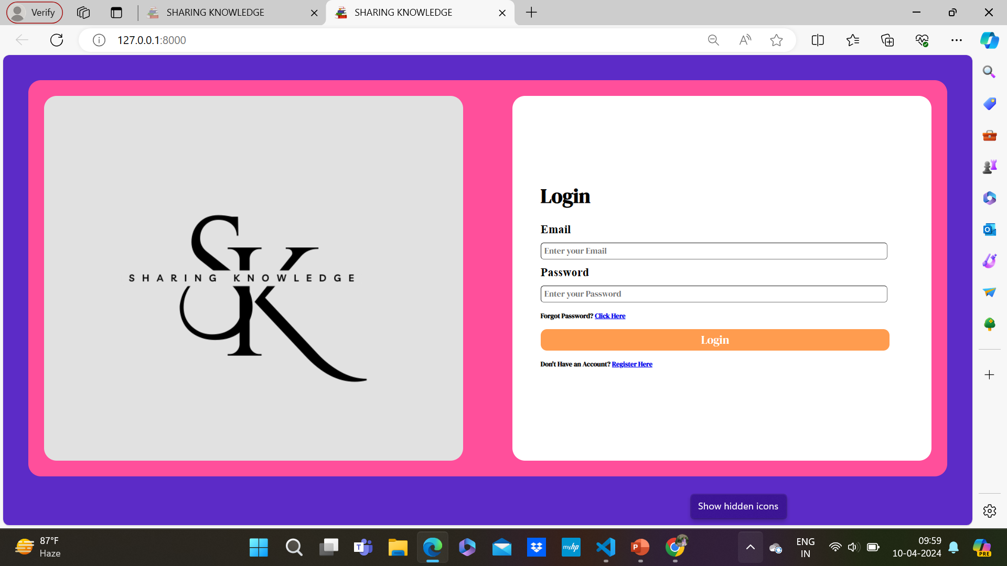
Home Page

Slide 10
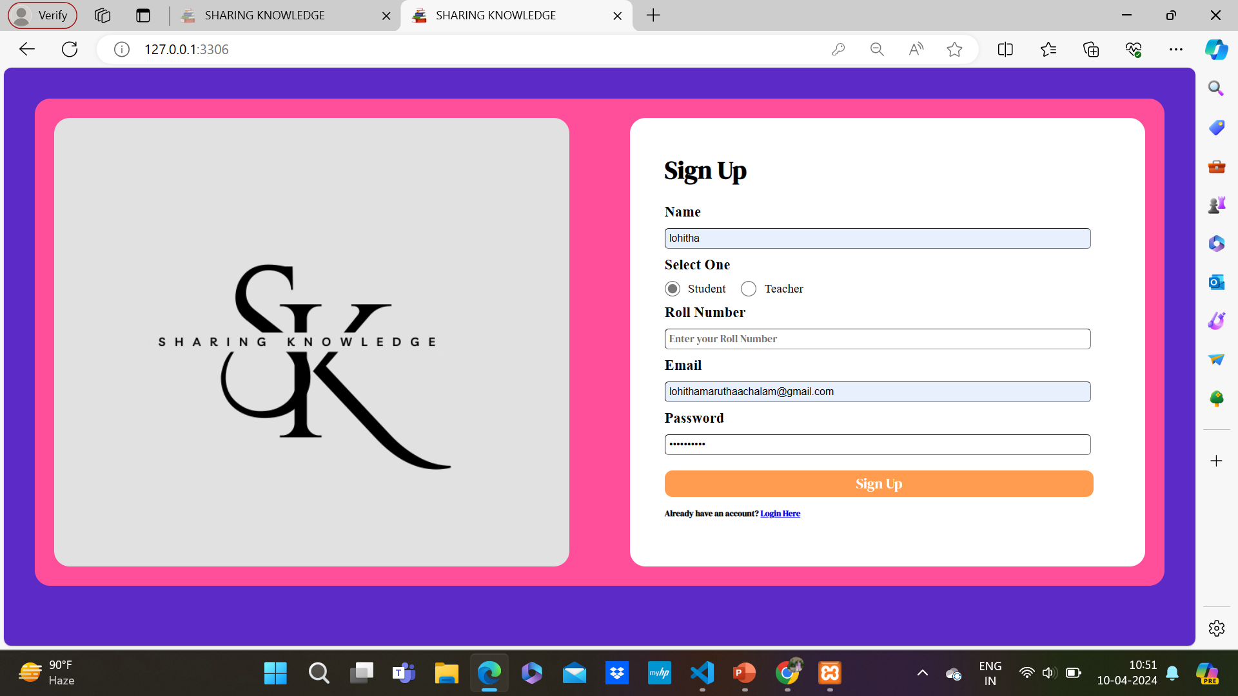
Student’s Login

Slide 11
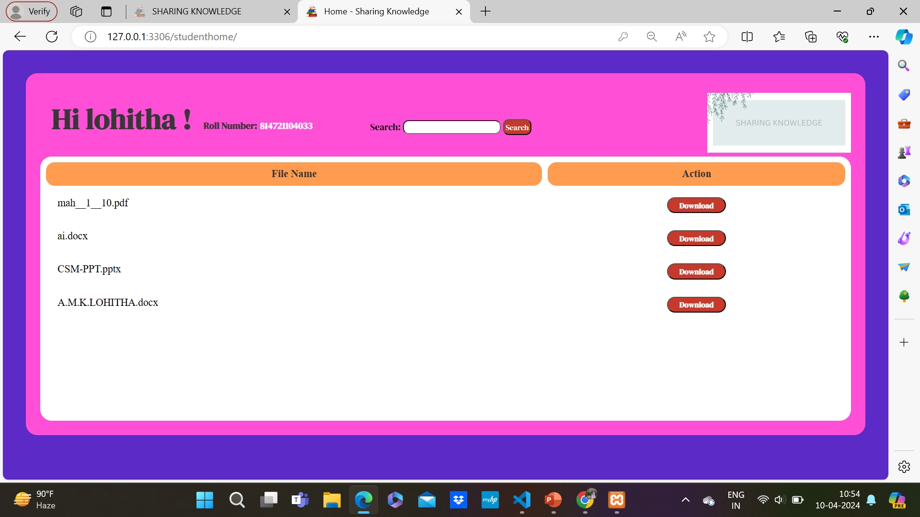
Student’s Page

Slide 12
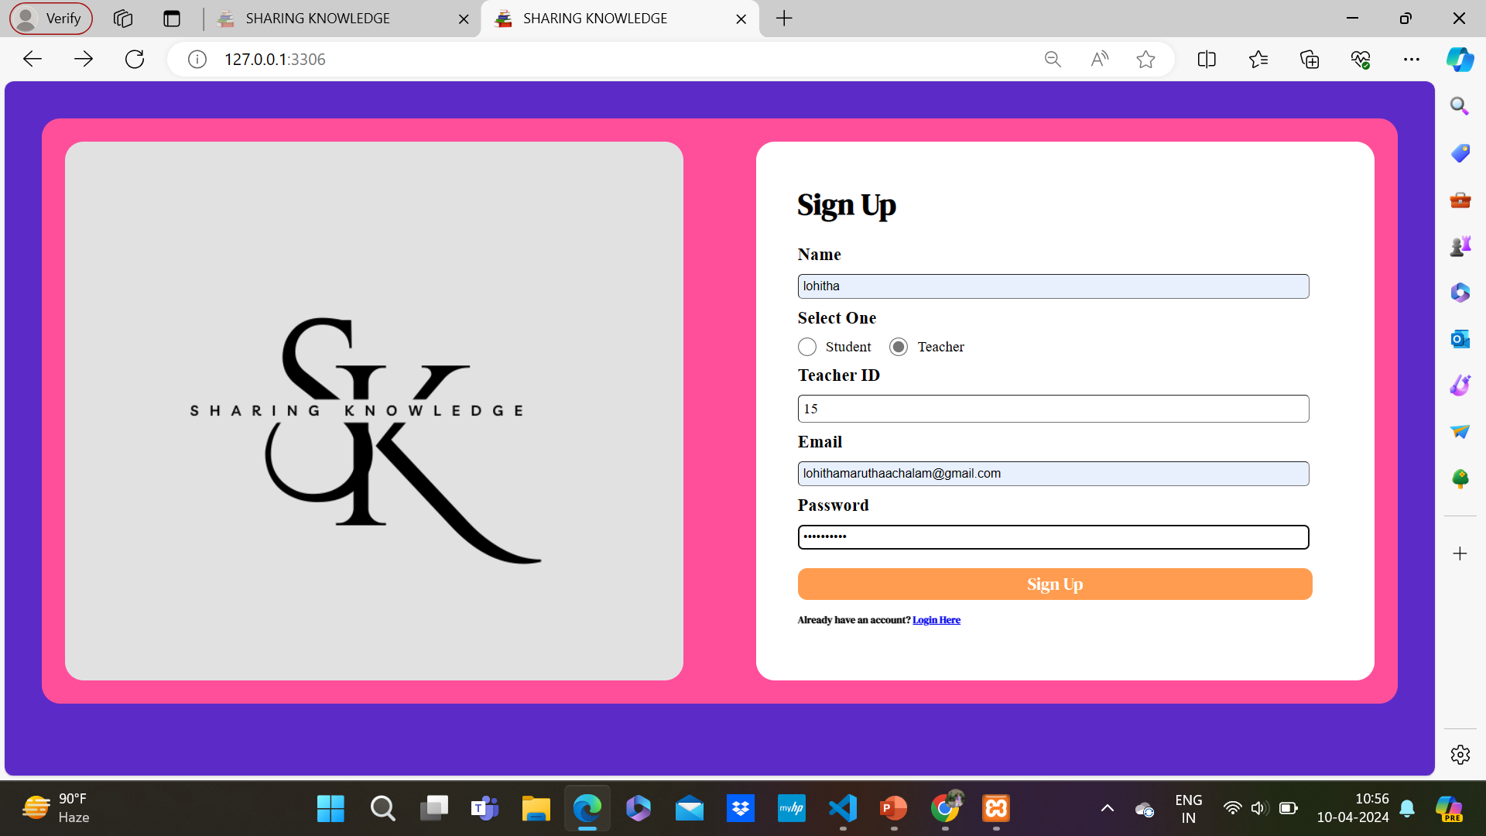
Teacher’s Login

Slide 13
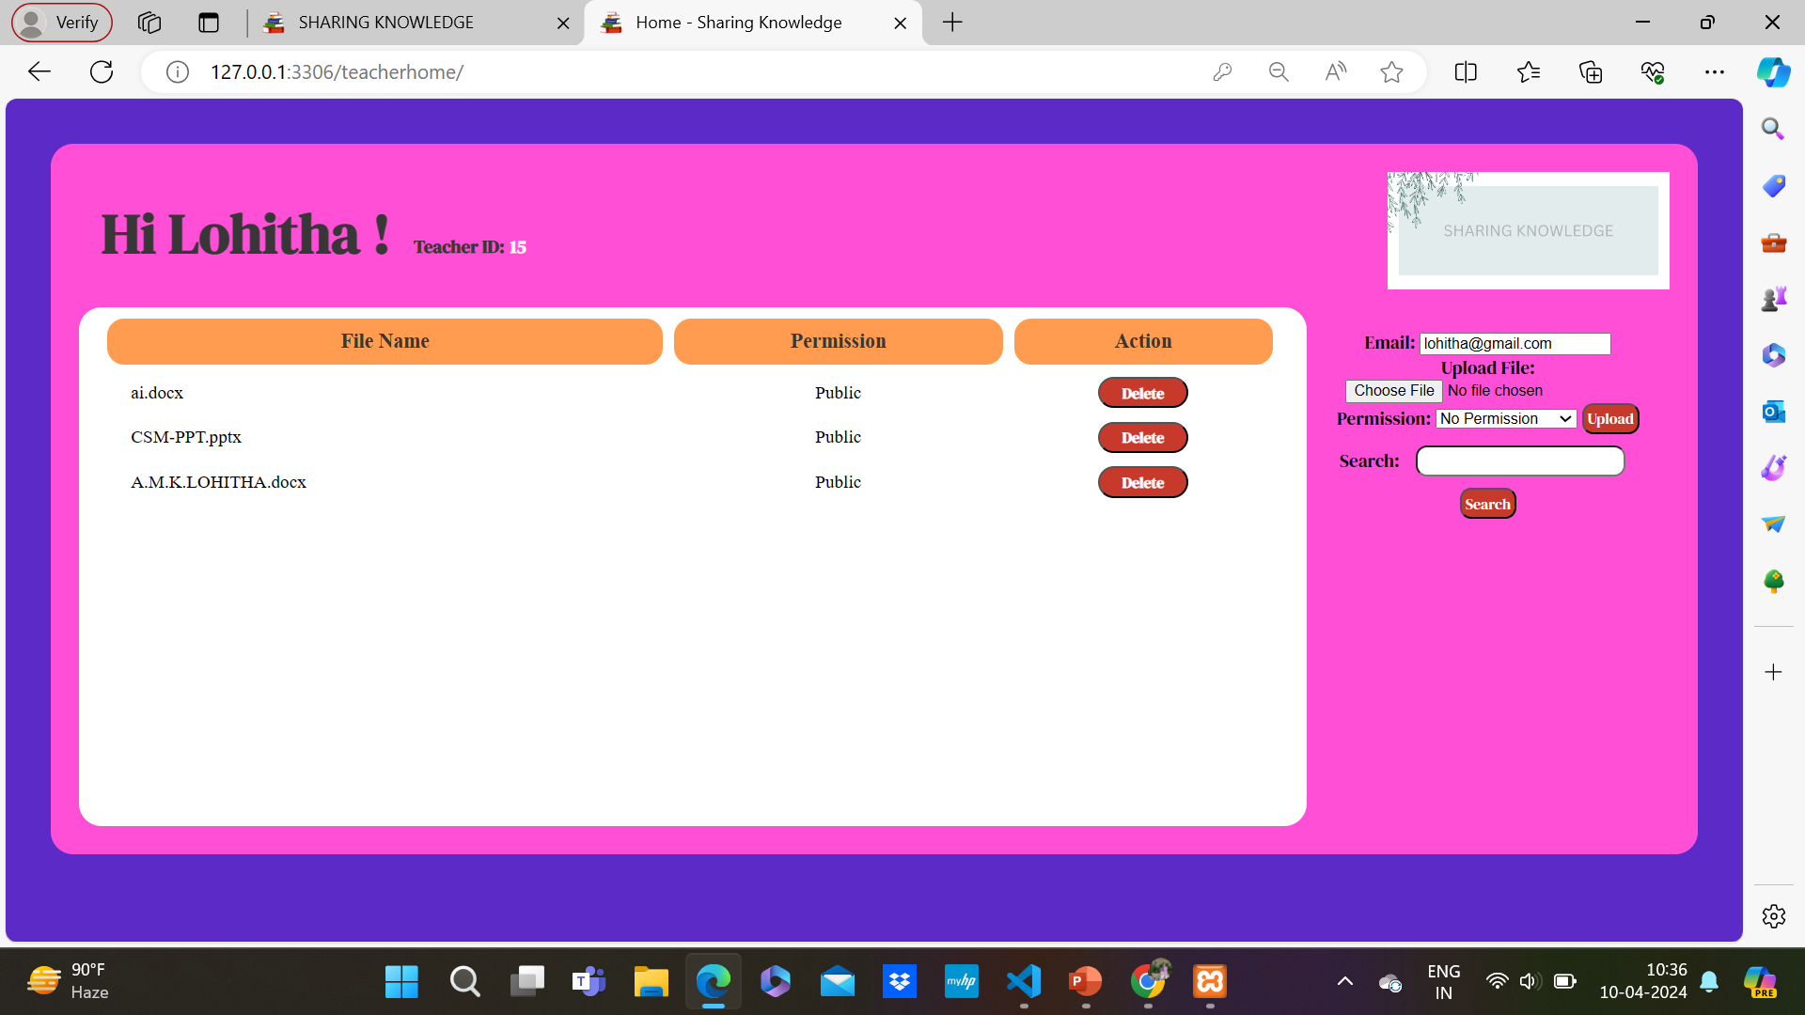
Student’s Page

Slide 14
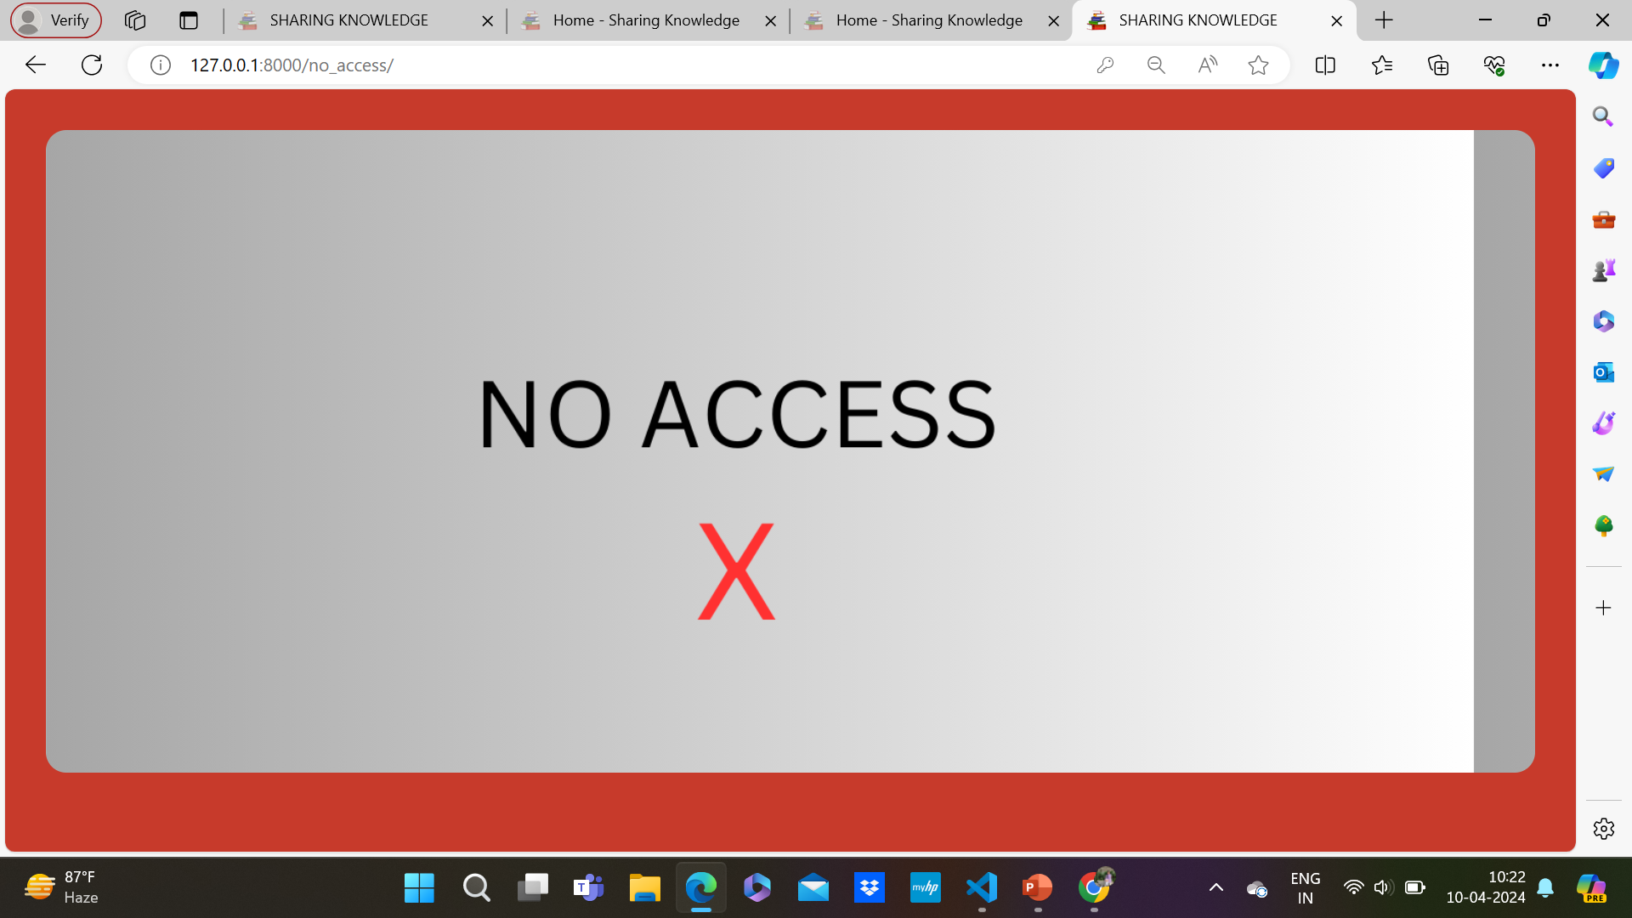
No Access

Slide 15
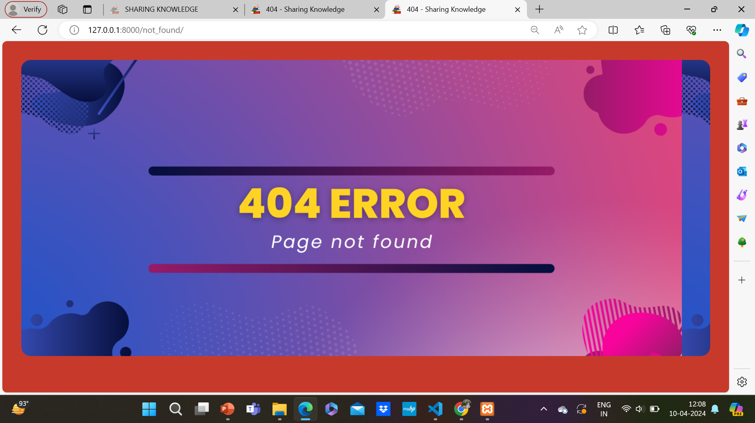
404 Error

Slide 16
Future Enhancements:
This document outlines future enhancements for a notes sharing web application, including user profiles, advanced search, file attachments, notifications, analytics, collaborative editing, LMS integration, a mobile app, gamification, and accessibility features. These enhancements aim to improve user engagement, collaboration, and overall user experience.
Real-time Collaboration
Offline Access
Cloud Storage Integration
Machine Learning Suggestions
Mobile Applications
Enhanced Security
Productivity Tool Integration
Customizable Templates
Analytics
Accessibility Improvements

Slide 17
Conclusion
In conclusion, the notes sharing web application has been designed to provide a platform for students and teachers to upload, share, and manage educational notes. The application includes features such as user authentication, note categorization, commenting, and role-based access control.
To further enhance the application, future developments could include user profiles, advanced search capabilities, file attachments, notifications, analytics, collaborative editing, LMS integration, a mobile app, gamification, and accessibility features. These enhancements aim to improve user engagement, collaboration, and overall user experience.
Source :

Slide 18
Thank You!
Notes:
Thank You !!

